Slide 1


HTML: The Foundation of the Web
Embark on a journey to understand the building blocks of every website.
by Abhishek Makwana

Slide 2
What is HTML and Why is it Important?
HyperText Markup Language
Foundation of the Web
Browser Display
The standard markup language for creating web pages.
Provides structure and content to websites.
Interpreted by browsers to display content.

Slide 3
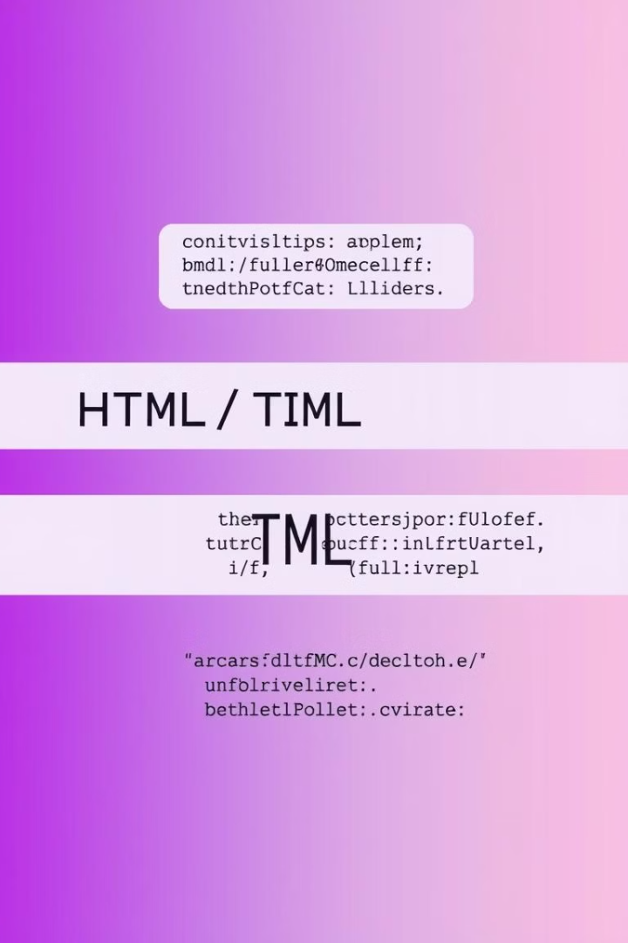



Basic HTML Structure
Tags
Keywords enclosed in angle brackets: <tag>.
Elements
A tag plus content: <tag>content</tag>.
Attributes
Modifiers: <tag attribute="value">.

Slide 4
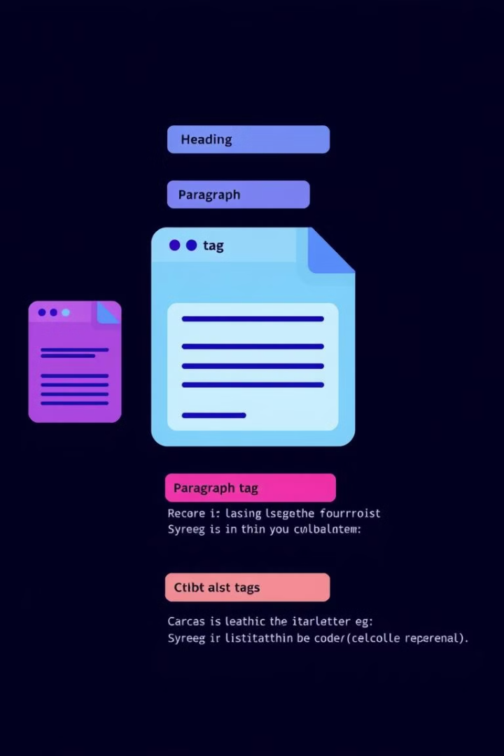


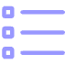
Common HTML Tags
Headings
Paragraphs
Lists
<h1> to <h6>: Define section titles.
<p>: Create blocks of text.
<ul>, <ol>, <li>: Organize content.

Slide 5

Working with Links and Images
1
Links
2
Images
<a href="url">text</a>: Connect to other pages.
<img src="url" alt="text" />: Display visuals.
3
Navigation
Essential for user experience.

Slide 6



Structuring Content
Spans
2
Inline containers for text.
Divs
1
Containers for sections or layout.
Organization
3
Grouping for styling and scripting.

Slide 7

HTML5 Semantic Elements
<article>
1
Self-contained composition.
2
<aside>
Tangentially related content.
<nav>
3
Section of navigation links.
4
<footer>
Information about the document.

Slide 8

Next Steps: Learning More
Online Courses
Documentation
Practice
Interactive tutorials and lessons.
MDN Web Docs and W3Schools.
Build small projects to reinforce understanding.

